Slide 1
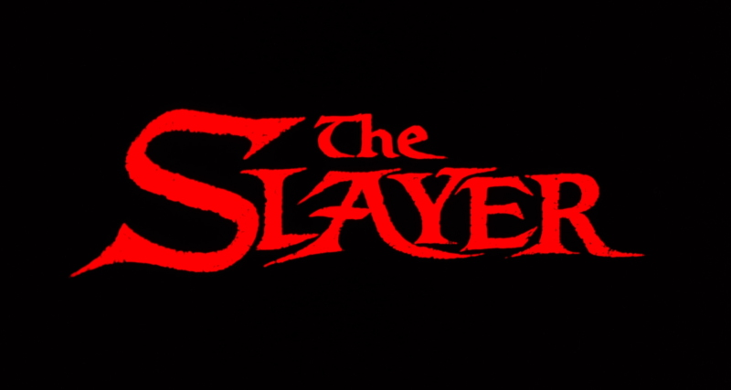
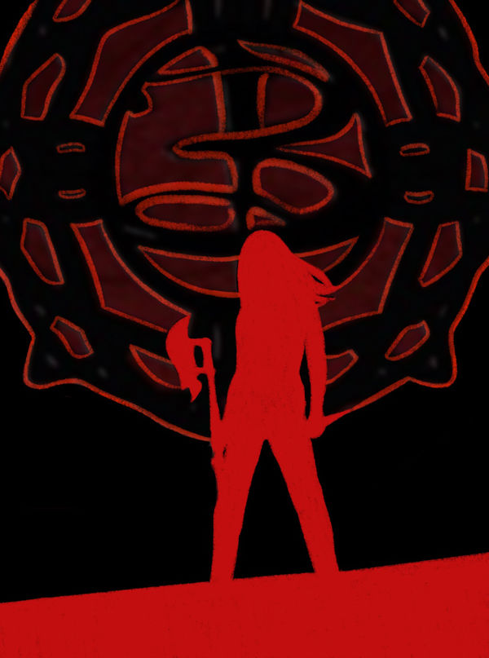
Pitch for VGTD By Epik Kat Gaming

Slide 2
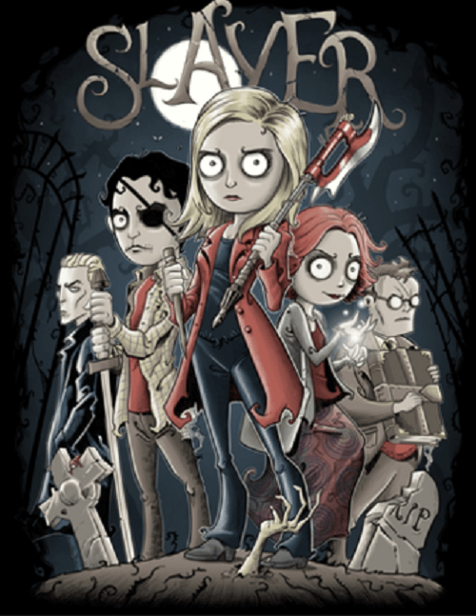

High Concept
Play as the slayer, watcher or witch and take on evil or you can choose to be a vampire, werewolf or a demon and strike down all that is good. Will you be the hero that fights for justice, stopping evil from destroying the earth or will you become the Villain, corrupting the innocent and become the greatest evil the land has ever seen.

Slide 3

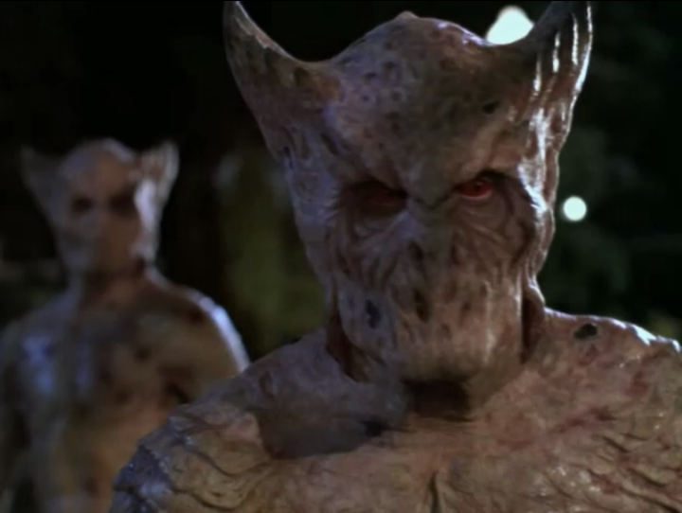

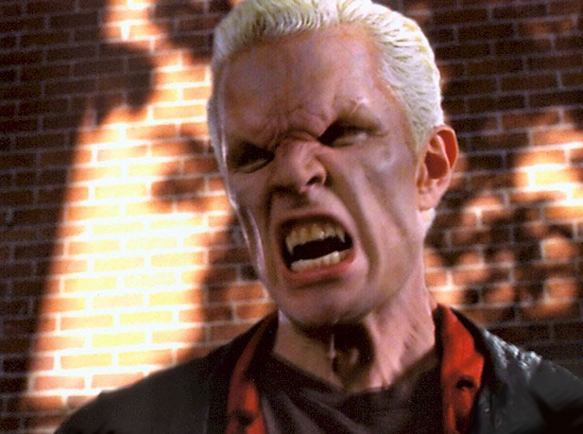
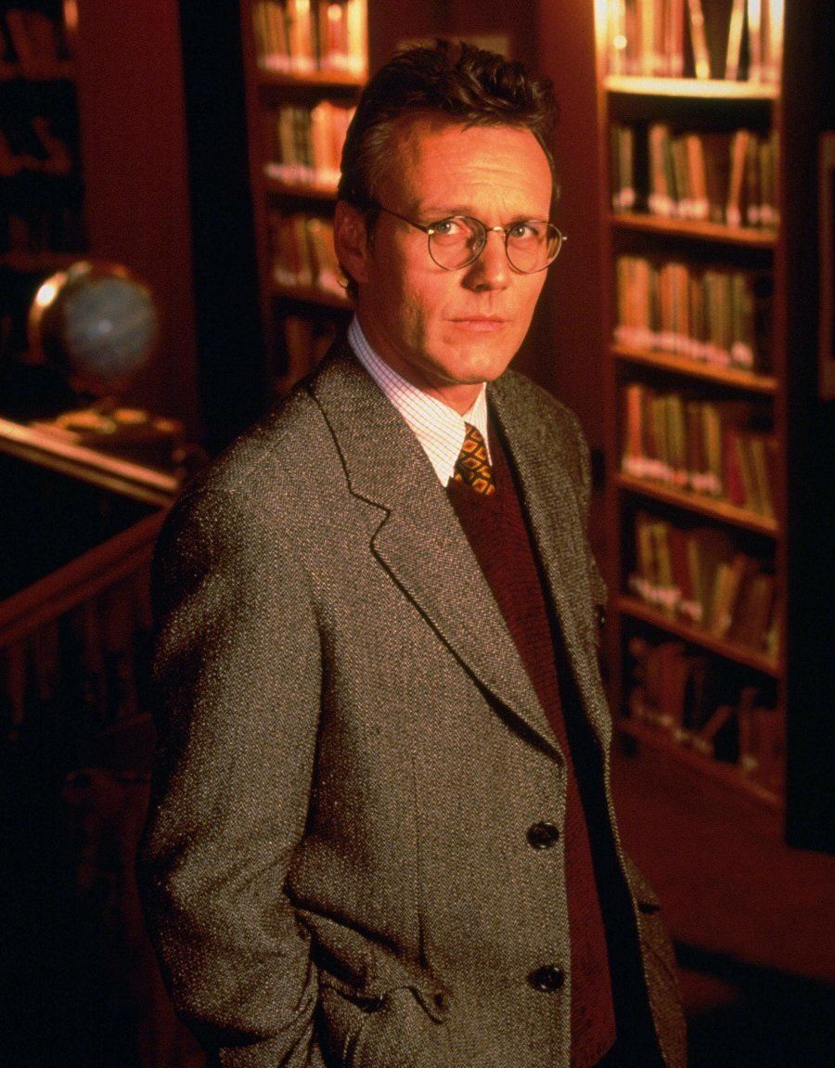

YOU CHOOSE
Good
EVIL

Slide 4


Story Outline
It’s been 15 years since the Buffy awakened all the slayers across the world. Demons, vampires, monsters and everything in between still wreak havoc upon the earth. The job of being a slayer is to make sure evil doesn’t win. You have a choice of playing as a customizable slayer, witch, or watcher in defending our world against threats. Or you can venture to the dark side and become a vampire, werewolf, or demon.

Slide 5


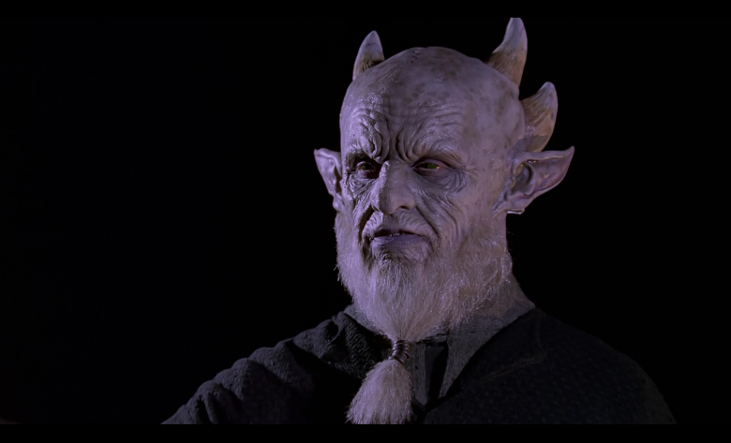
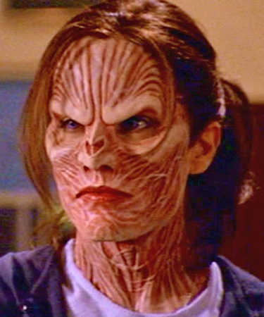
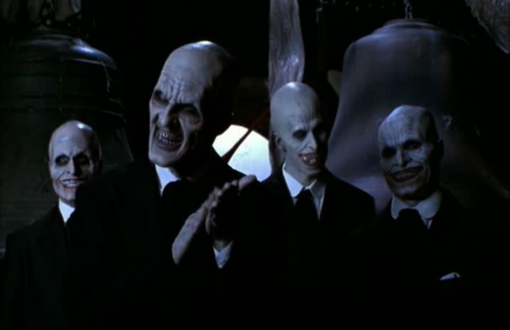

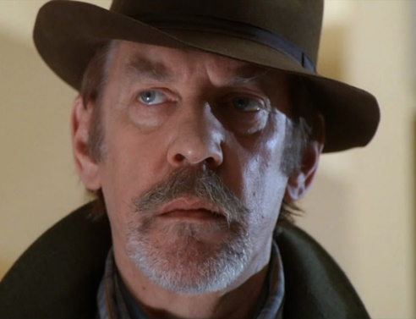


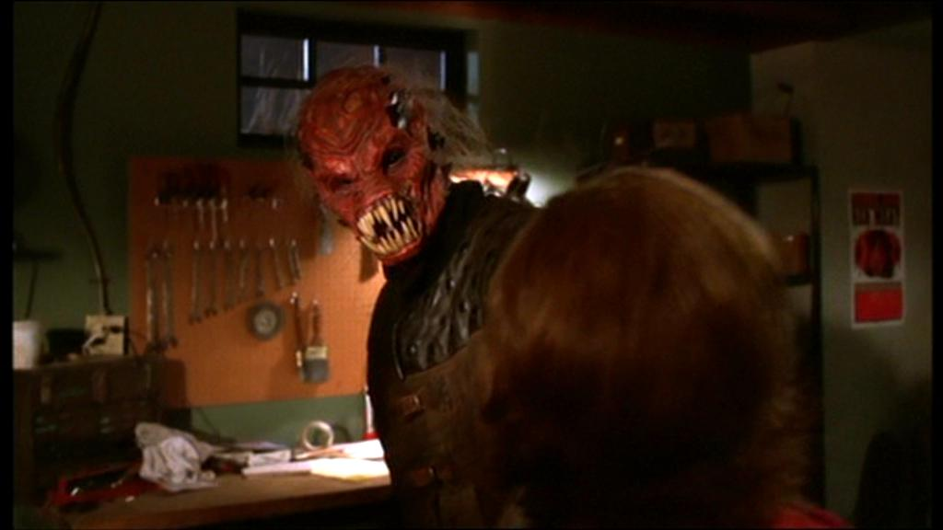
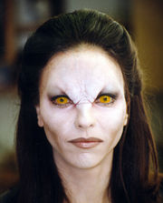
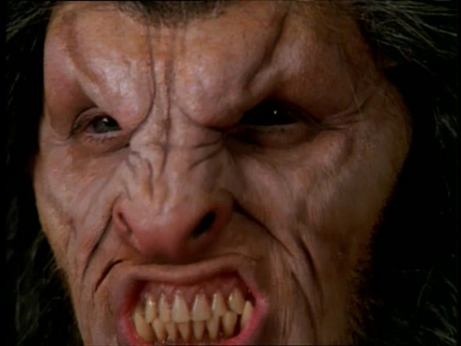

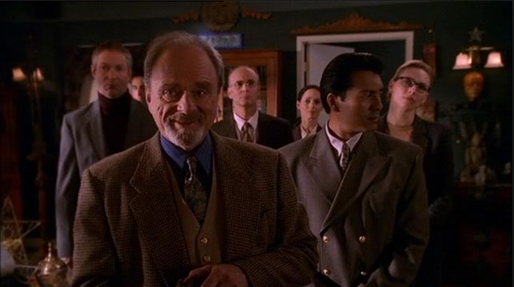
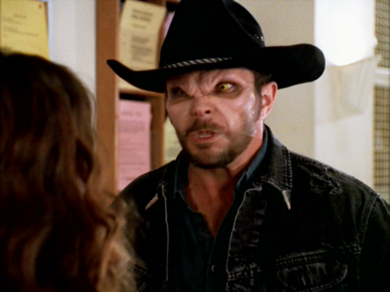

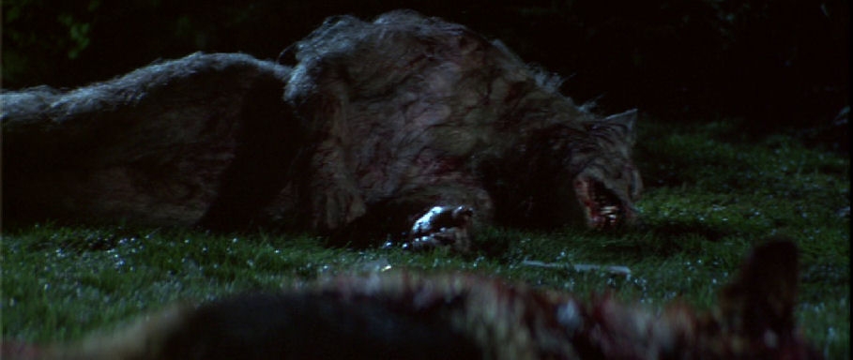
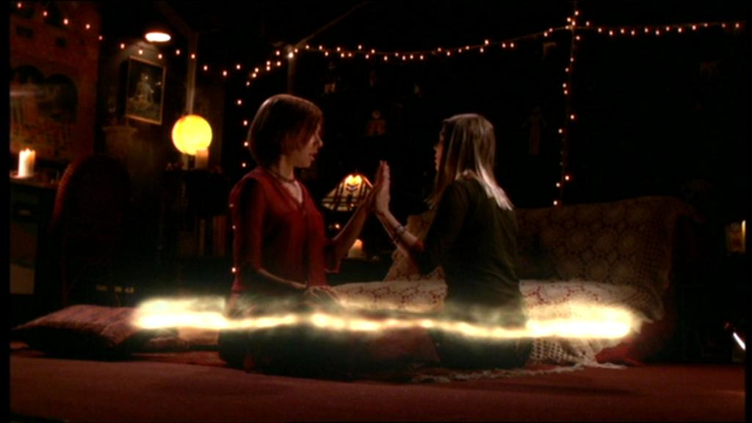
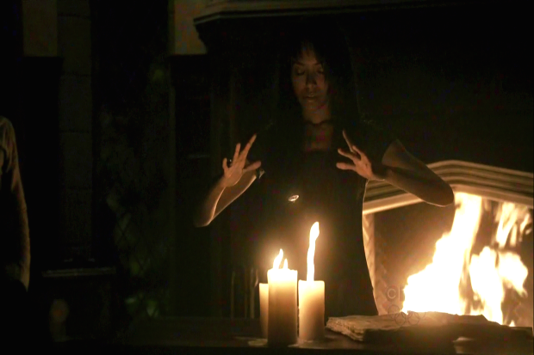

Slide 6
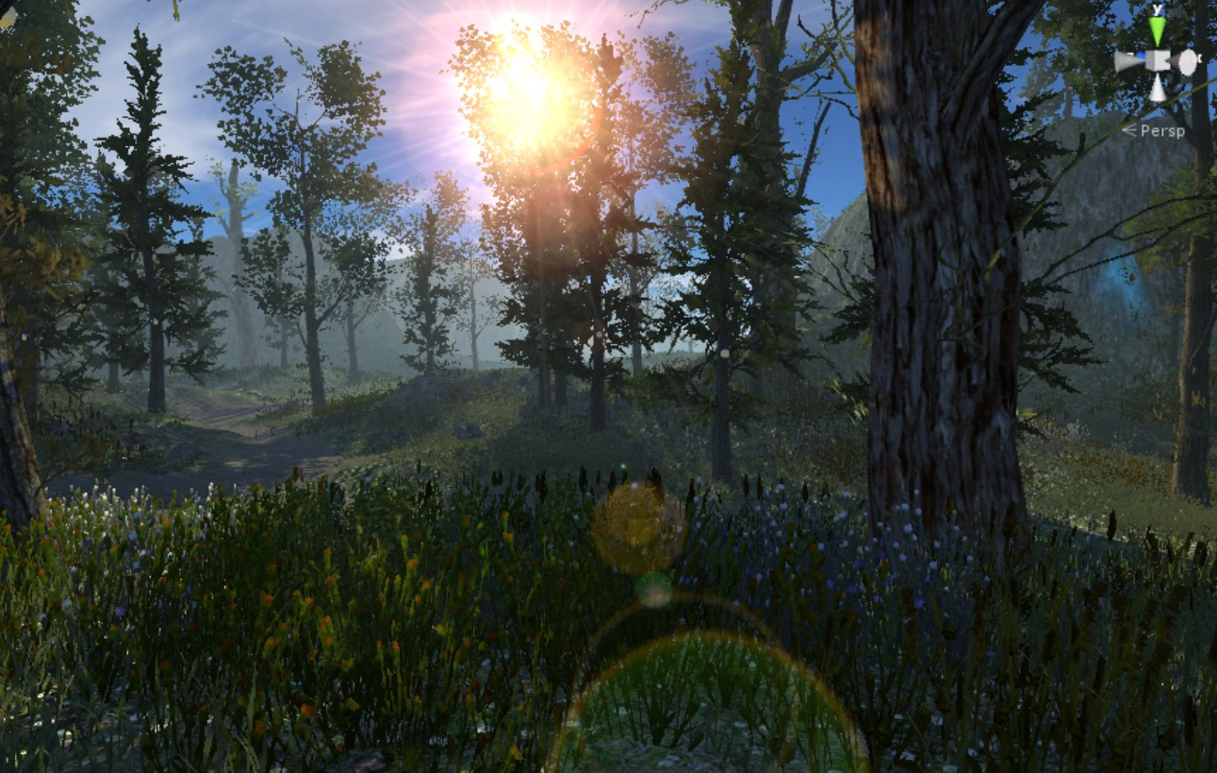
Game Play
The player controls their character in a 3D world exploring, adventuring battling against AI enemies which will give the player experience upon defeating each one. The player can accumulate experience points to use on stats and abilities and level increasing. Each level the player gains gives them more access to abilities for their own specific class. Players can buy with game coins (collected from each enemy they kill) different armors, weapons, styles of clothes, items, etc.

Slide 7
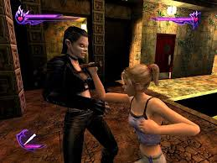
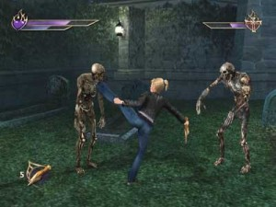

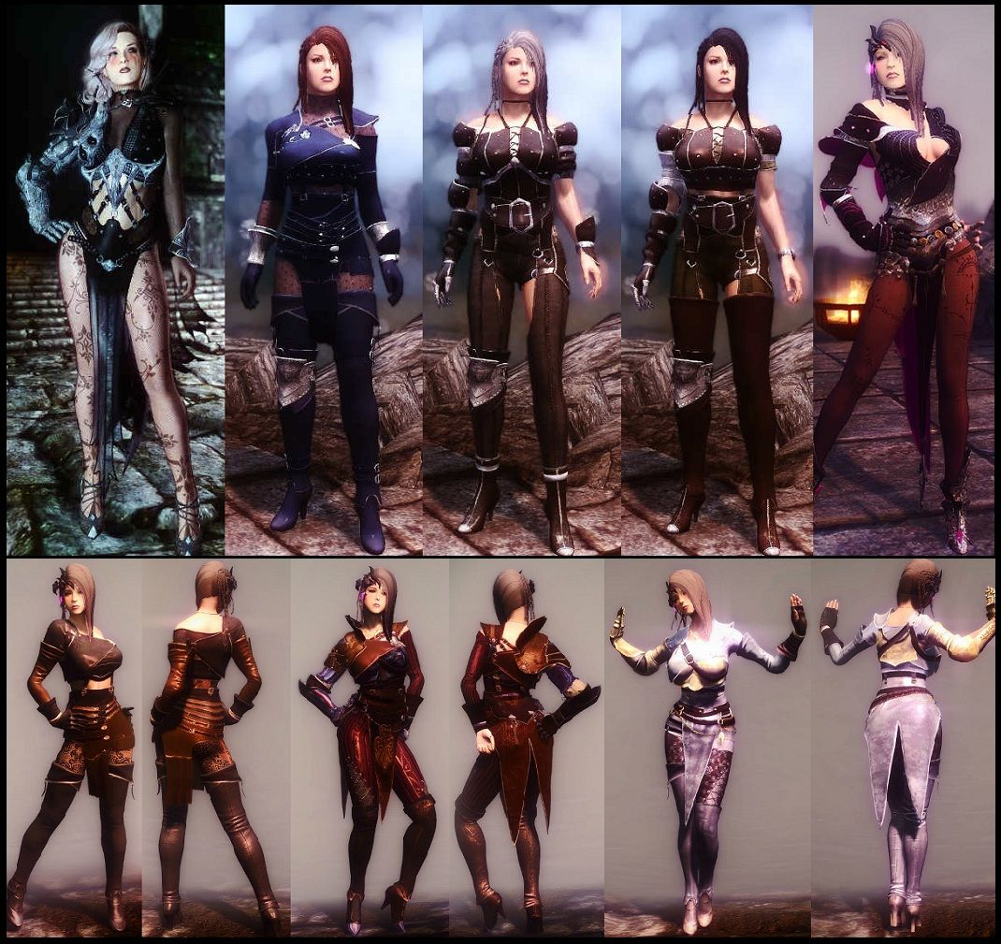
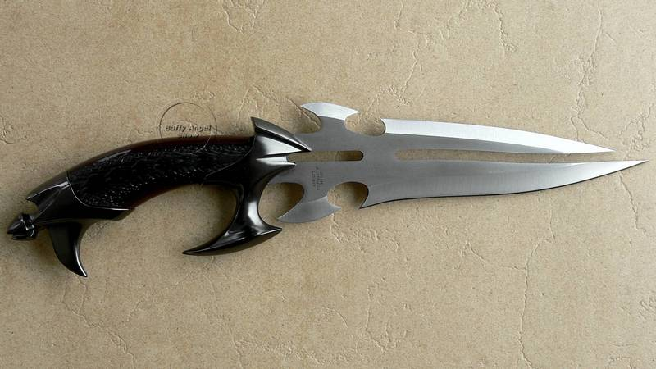
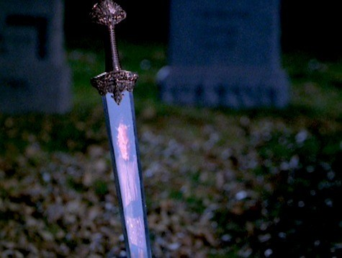
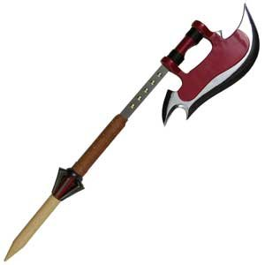
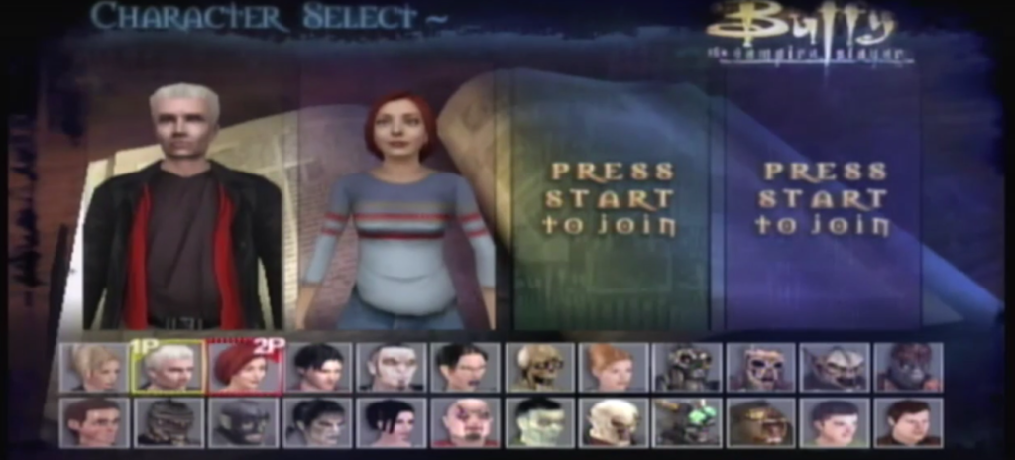
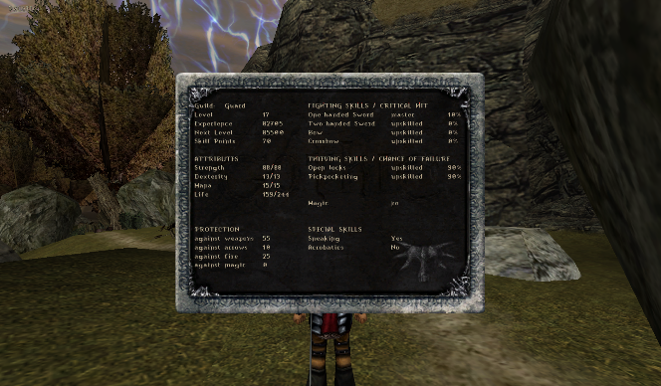
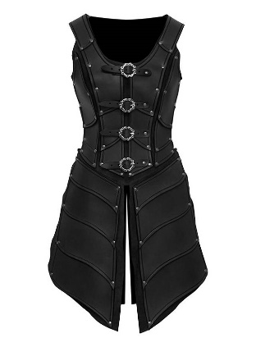
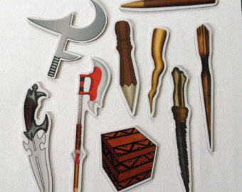
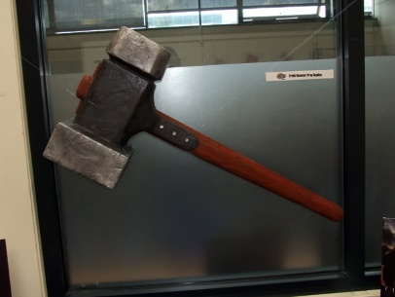
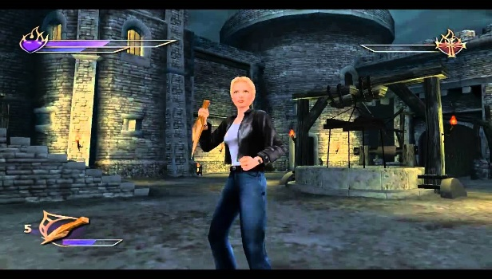

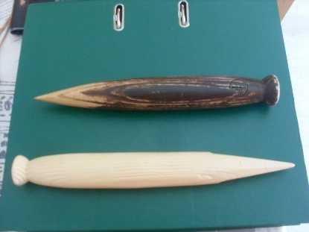
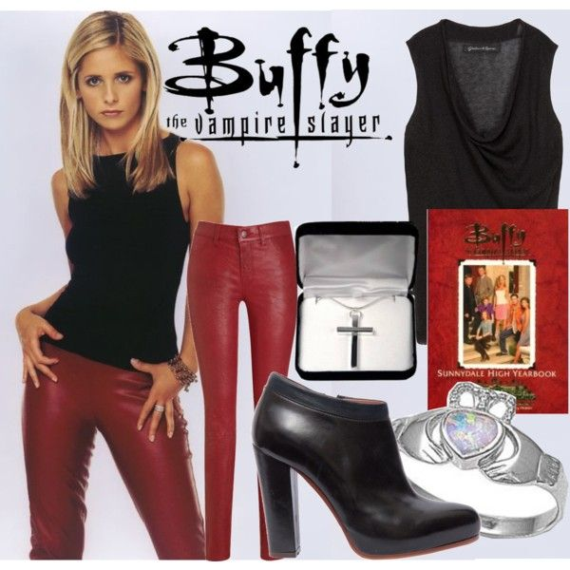
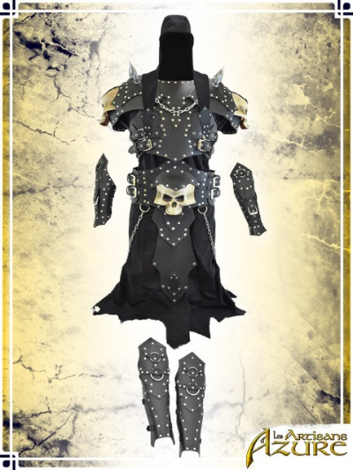
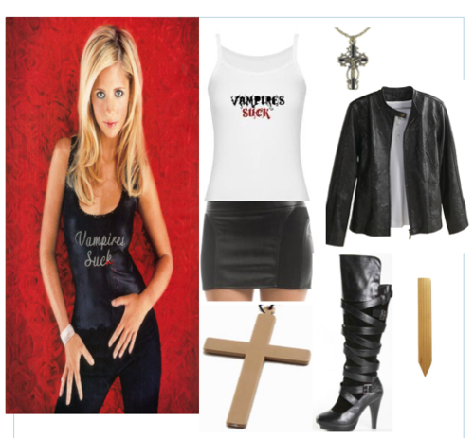
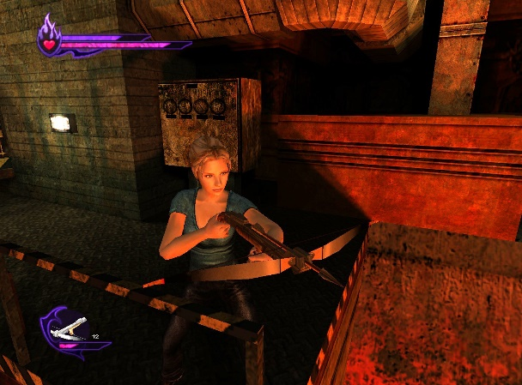
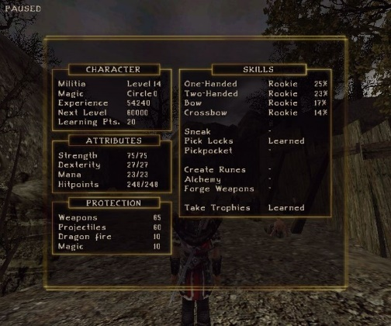


Slide 8
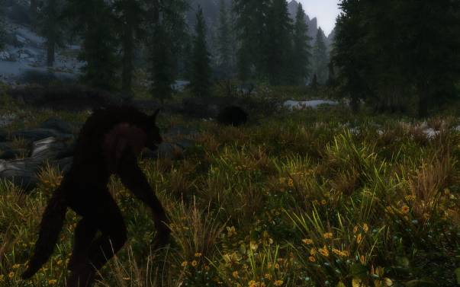




PLATFORMS

Slide 9

Development Time
Brainstorming – 2 weeks
Narrative Story Writing – 4 weeks
Concept Art and Research – 6 weeks
2D elemental Design – 12 weeks
3D Modeling – 20 weeks
Map Design – 10 weeks
Flash Menu Integration – 6 weeks
UV Mapping and Texture Design – 22 weeks
Motion Graphics and Video Integration – 10 weeks
Sound Productions – 10 weeks
Sound Recordings – 4 weeks
Unreal Editor Integration – 8 weeks
Play Testing – 6 weeks

Slide 10
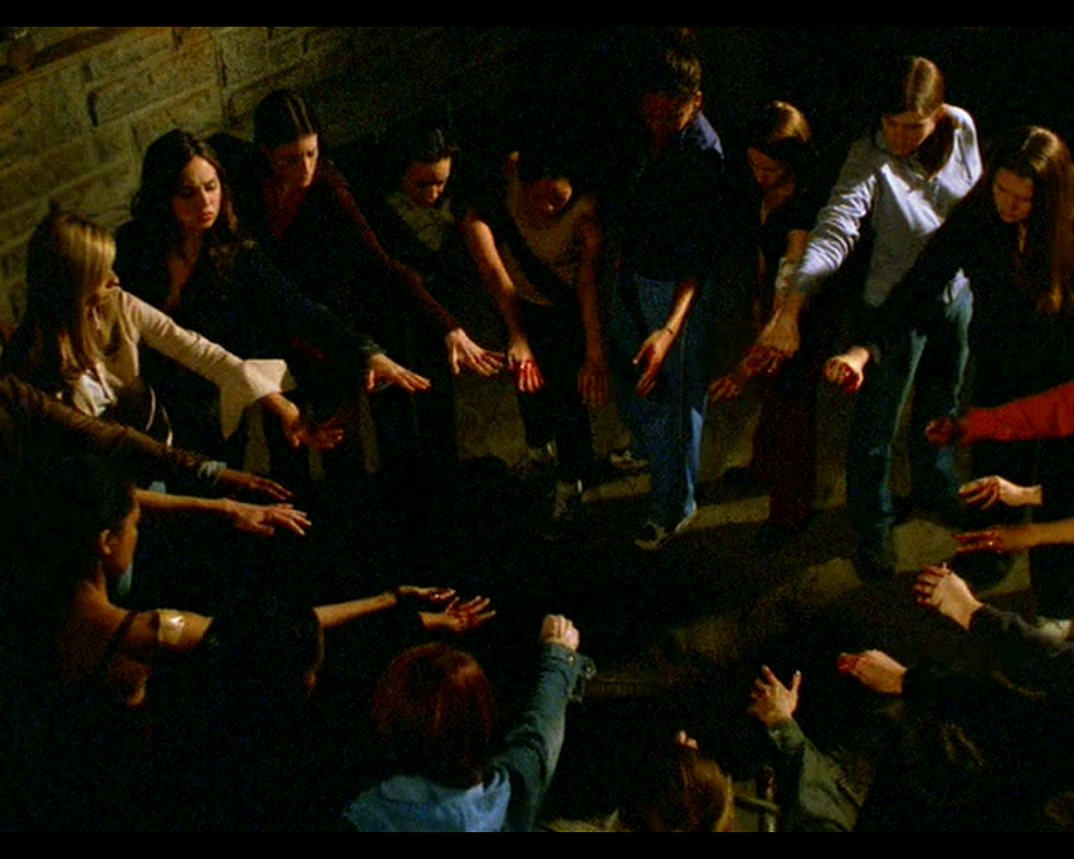
SUMMARY
You learn techniques and improve your skills. Build your own personal weapons, everything from wooden stakes and crosses to crossbows and swords as you venture out fighting evil or taking on the good guys. Find items to make weapons, search for books and relics to help you along your journey. Meet fellow slayers, witches and watchers and band together to fight evil or make your own brood and stop the good guys from winning. Find places where evil lurks and fight your way through gaining levels and experience. You start with basic moves like walking, jumping, crouching, kicking and punching, but as you gain levels you can choose different fighting styles and techniques or you can become proficient in certain weapons or magic’s. You have control of your destiny, good or evil, either way a lot of butts are going to get kicked. You decide!!!

Slide 11
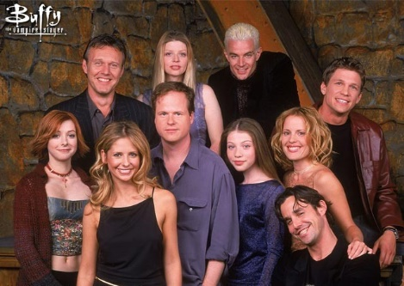
Licensing
We will need to acquire a license to use some of the lore, characters and names from the original creator of Buffy The Vampire Slayer, Joss Whedon.

